Slide 1

Australian Household Consumption and Expenditure Pattern
A study from 2012 – 2022
Presented by:
Emma H, Kit N, Md Muhasenul H
November 2022

Slide 2
Project Proposal
Our project seeks to uncover the trend and pattern in Australian household consumption and expenditure.
We will examine where do fellow Aussies spend their money. How has the consumption pattern changed over the last ten years?
We will explore if there is any possible Covid pandemic stimulated changes in consumption pattern. What are some of the possible explanations?
We will further examine relationships between Australian household consumption pattern and some key economic indicators?
We will examine relationships between Australian household consumption pattern and movement in BTC price movement.

Slide 3
Data Source
To study the Australian household final consumption and expenditure pattern, we have used:
Household final consumption expenditure, chain volume measures, seasonally adjusted data published by the Australian Bureau of Statistics (ABS)
To examine relationships between Australian household consumption pattern and key economic indicators, economic data are source from ABS. Data used are:
Unemployment rate, seasonally adjusted
Household saving ratio, seasonally adjusted
What are chain volume measures?
Chain volume measures are constant price estimates. This metric measures consumption volumes by removing the part inflated by price increases. It provides better indication of movement in expenditure.
What is seasonally adjusted data?
Seasonally adjusted mean the data has been modified to eliminate the effect of seasonal and calendar influences. The seasonally adjusted data better reflect the true patterns in the underlying consumption activity.
It allows for more meaningful comparisons from period to period.

Slide 4
Data Cleanup and Exploration

Slide 5
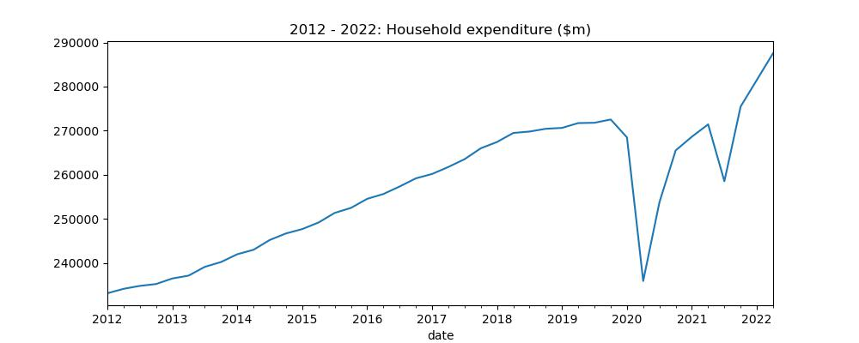
Trend and pattern in Australian household consumption and expenditure
YoY increase
Plateau
Covid impact

Slide 6
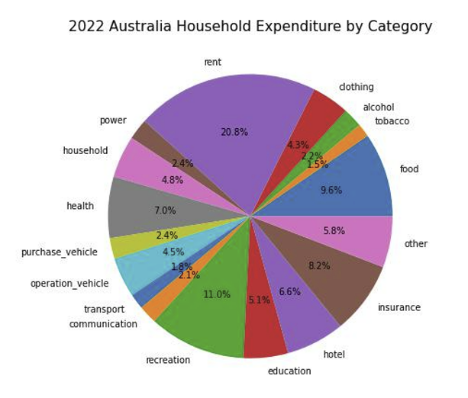
Where do we spend our money?

Slide 7
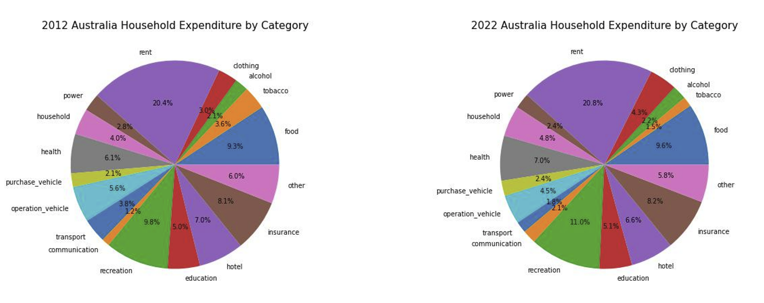

Slide 8
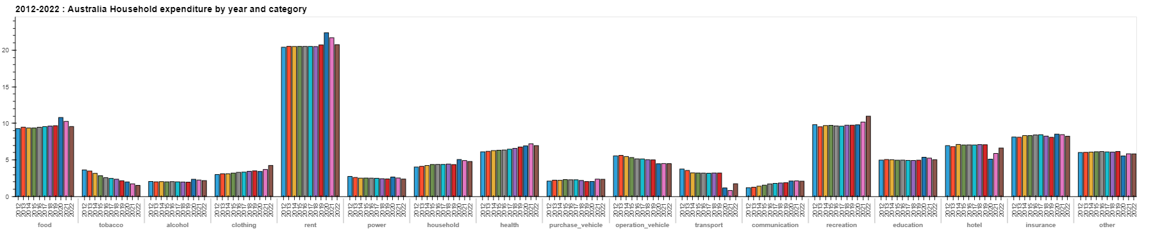

Slide 9
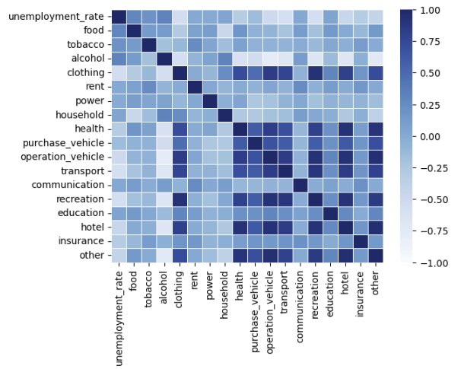
Hypothesis:

Slide 10
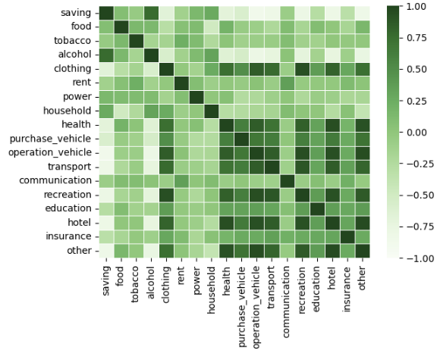
Hypothesis:

Slide 11
Future Development
Questions that couldn’t be answer due to time constraints
What would we research next if you have two more weeks

Slide 12

Questions

Slide 13


